Slide 1



Datalynx DMS
This is the Datalynx DMS Readme file.
It provides an overview of the DMS platform and contains instructions and links for downloading and installing a trial version of DMS Data Xplorer.
www.datalynx.com.au

Slide 2

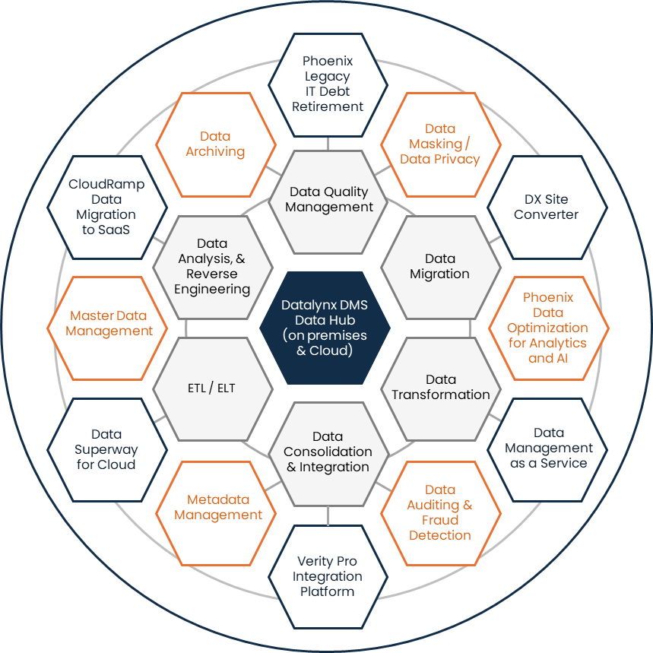

Datalynx DMS
Data Solutions Platform
Datalynx DMS:
Comprises two systems:
Data Xplorer & Data Xchange
No-code platform for rapidly configuring data-related solutions
Extensive inbuilt IP and accelerators
Operates within and across cloud and hybrid environments
The most complete data solution platform on the market
Created to solve real-world challenges
Track record of 20+ years of successful solution delivery in large and complex business environments
© Copyright Datalynx Pty Ltd 2024 – all rights reserved

Slide 3



Download, Install and Register
Introduction: https://youtu.be/VJwL1mqbW7o
Data Xplorer Download: https://github.com/Datalynx-Australia/DMS-Data-Xplorer
How to install: https://www.youtube.com/watch?v=IgF1gDGbz5M
Get Product Key : https://shorturl.at/dvJV8
www.datalynx.com.au

Slide 4





Follow Us / Contact Us
www.youtube.com/@DatalynxAustralia
https://www.linkedin.com/company/datalynx
https://twitter.com/DatalynxAus
https://www.facebook.com/profile.php?id=61558087606463
Sales: sales@datalynx.com.au
Support: support@datalynx.com.au
Level 30, 100 Miller Street, North Sydney, NSW, 2060 Australia
www.datalynx.com.au

Slide 5

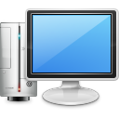
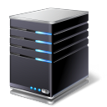
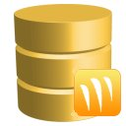



Single Machine Installation
DMS Client PC / Application Server
DMS Repository
Configuration
Configuration
Windows 10 or higher/
Windows Server 2016 or higher
Minimum 4 CPU cores
Minimum 200 GB free disk
Minimum 8GB RAM
MS Word & Excel (2016 or higher)
Optional:
  Oracle 32-bit client
  Access Database Engine 2016
  Microsoft Visual C++ Redistributable
SQL Server 2016 or higher
OR
Oracle Cloud 12c or higher
Note: The system requires 3 separate databases or schemas , one for the security system and the other two are for the both the Data Xchange and the Data Xplorer systems
Privileges
Privileges
Administrative access required to:
Install software
View system logs
Create system folders
Copy files to and from the PC
Create / Drop database objects
Read, Update, Insert, Delete
© Copyright Datalynx Pty Ltd 2024 – all rights reserved

Slide 6

Multi Machine Installation
DMS Client PC
DMS Application Server
DMS Repository
Shared File
Storage
Configuration
Configuration
Configuration
Windows 10 or higher
Minimum 4 CPU cores
Minimum 100 GB free disk
Minimum 8GB RAM
MS Word & Excel (2016 or higher)
Optional:
  Oracle 32-bit client
  Access Database Engine 2016
  Microsoft Visual C++ Redistributable
Windows 10 or higher/
Windows Server 2016 or higher
Minimum 8 CPU cores
Minimum 200 GB free disk
Minimum 16GB RAM
MS Word & Excel (2016 or higher)
Optional:
  Oracle 32-bit client
  Access Database Engine 2016
  Microsoft Visual C++ Redistributable
SQL Server 2016 or higher
OR
Oracle Cloud 12c or higher
Note: The system requires 3 separate databases or schemas , one for the security system and the other two are for the both the Data Xchange and the Data Xplorer systems
Privileges
Privileges
Privileges
Administrative access required to:
Install software
View system logs
Create system folders
Copy files to and from the PC
Administrative access required to:
Install software
View system logs
Create system folders
Copy files to and from the PC
Create / Drop database objects
Read, Update, Insert, Delete
© Copyright Datalynx Pty Ltd 2024 – all rights reserved

